Slide 1
Intro to Coding with Python– Classes Pt 3
Dr. Ab Mosca (they/them)
Slides based off slides courtesy of Jordan Crouser (https://jcrouser.github.io/)

Slide 2
Plan for Today
Recap classes
Object-Oriented Programming
Child classes
Inheritance

Slide 3
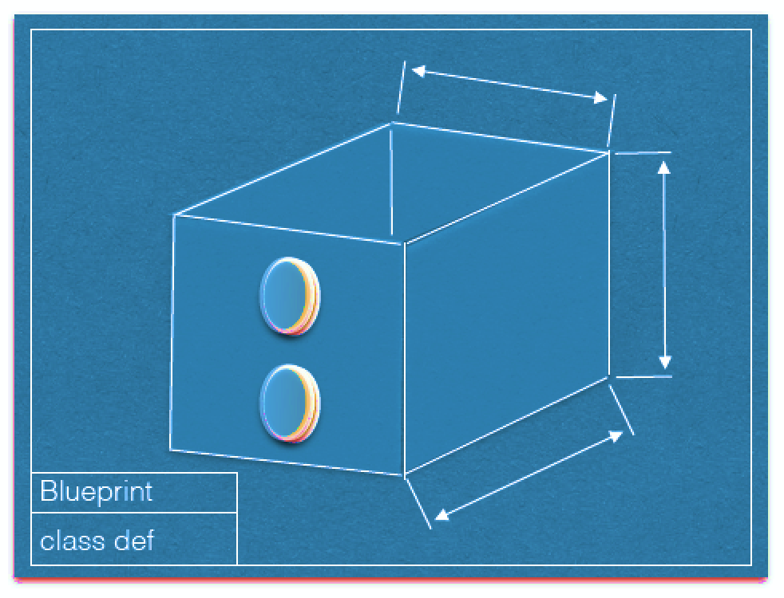
RECAP: class definitions (“blueprints”)
attributes
methods()
Image courtesy Dominique Thiebaut, Smith College

Slide 4
10 Minute activity: Artist class
Define an Artist class
An Artist should have the attributes:
name
birth year
death year
An Artist should have the method:
print_info that prints:
“Artist: <name>, born: < birth year>” if the artist is alive and
“Artist: <name>, < birth year> - <death year>” if the artist is dead

Slide 5
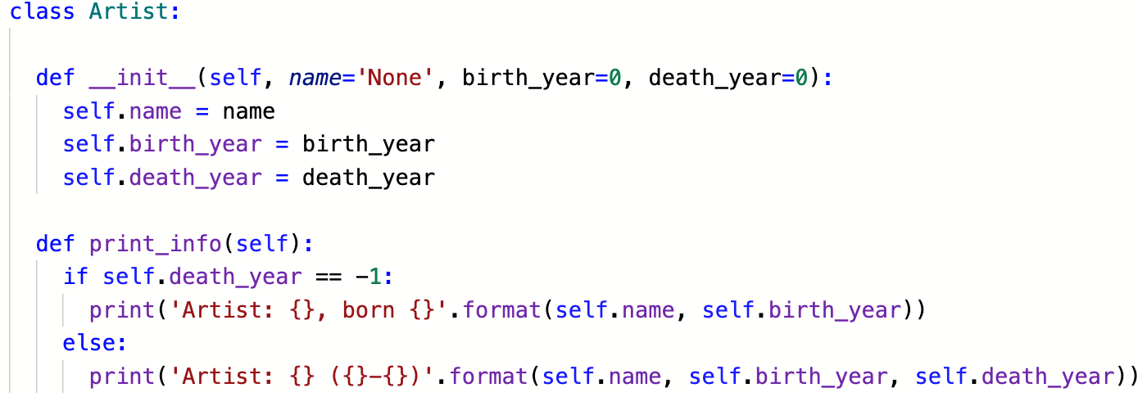
Coding the Artist class

Slide 6
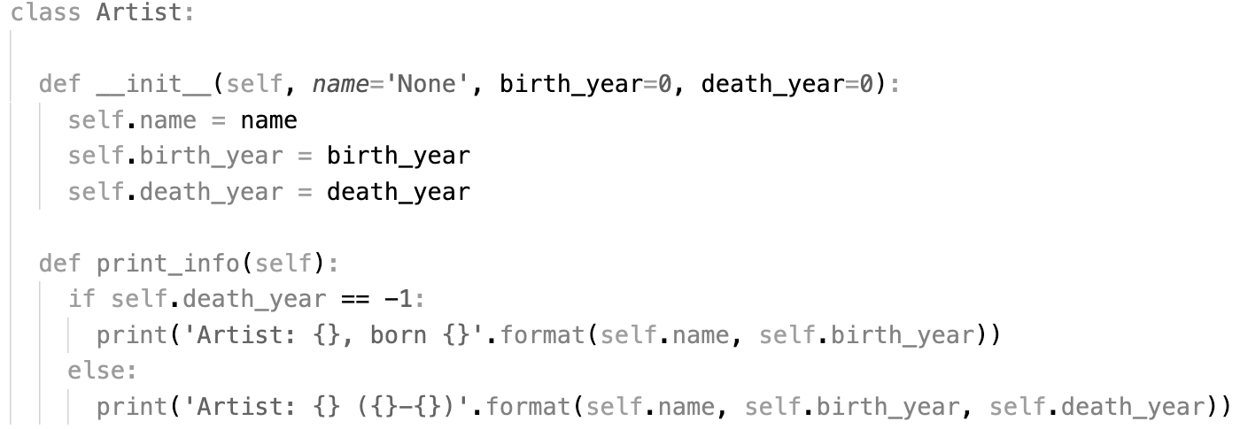
Coding the Artist class
the
constructor

Slide 7
Coding the Artist class
attributes

Slide 8
Coding the Artist class
default values

Slide 9
Coding the Artist class
method

Slide 10
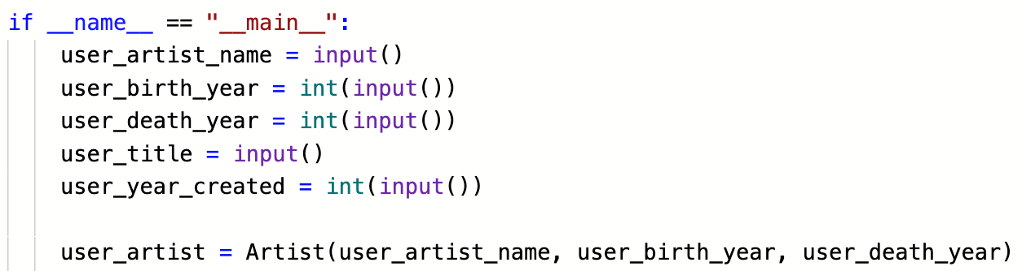
Creating an Artist instance

Slide 11
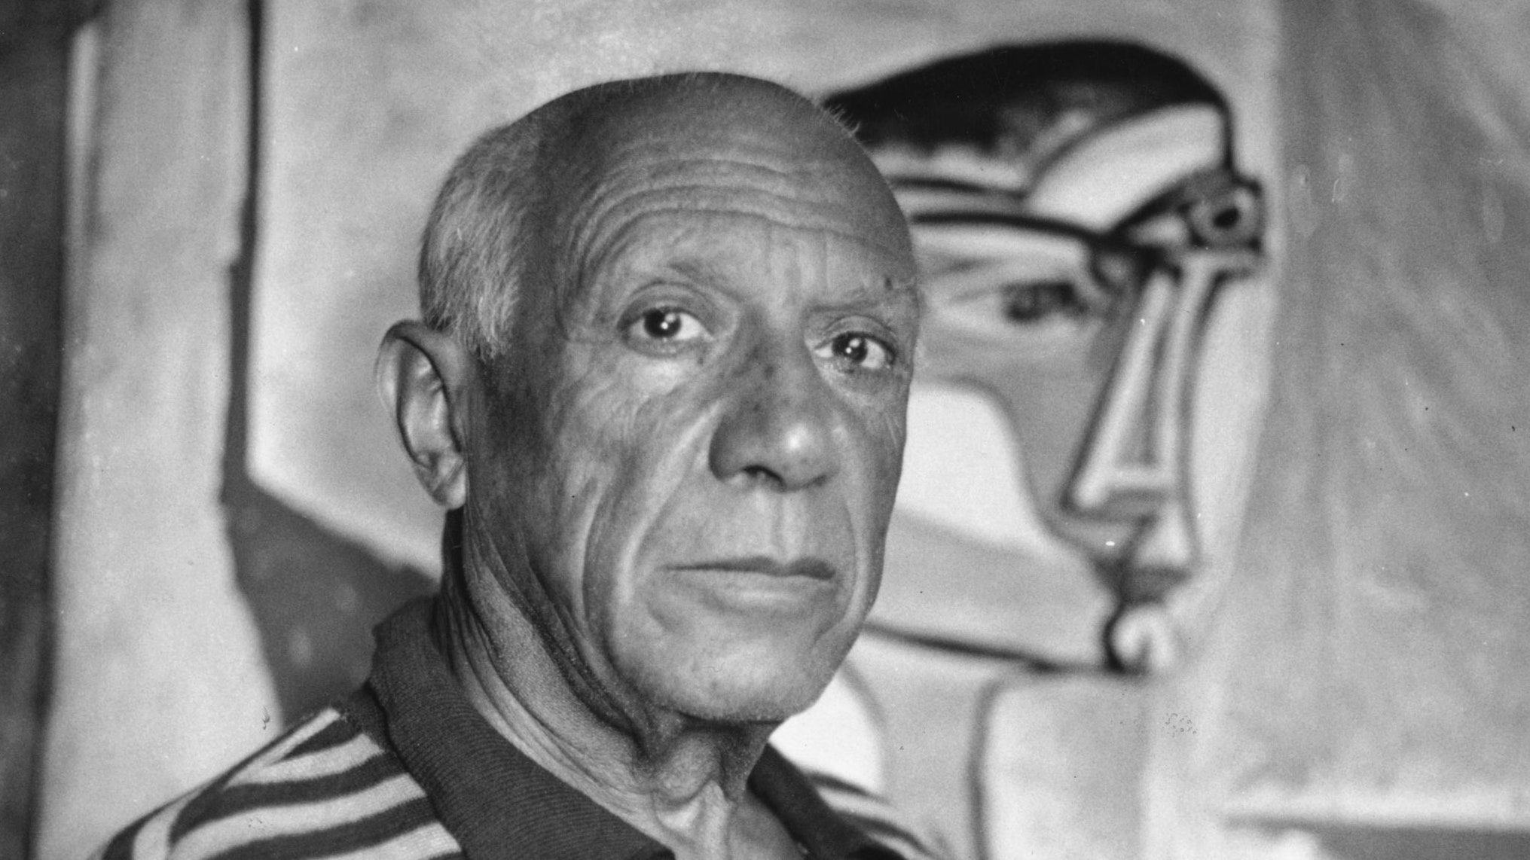
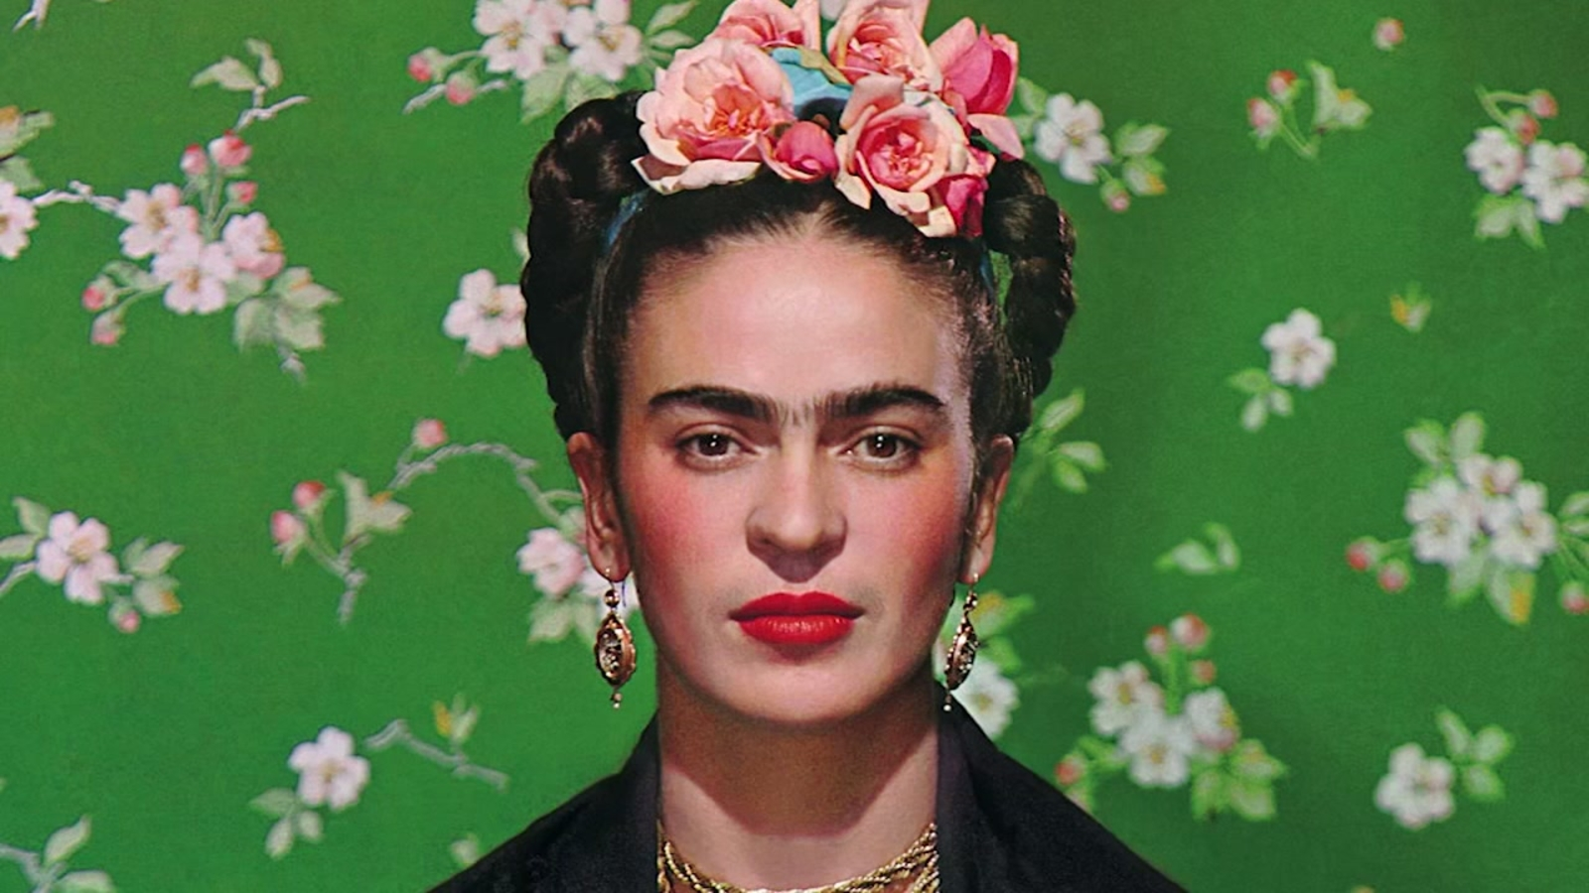
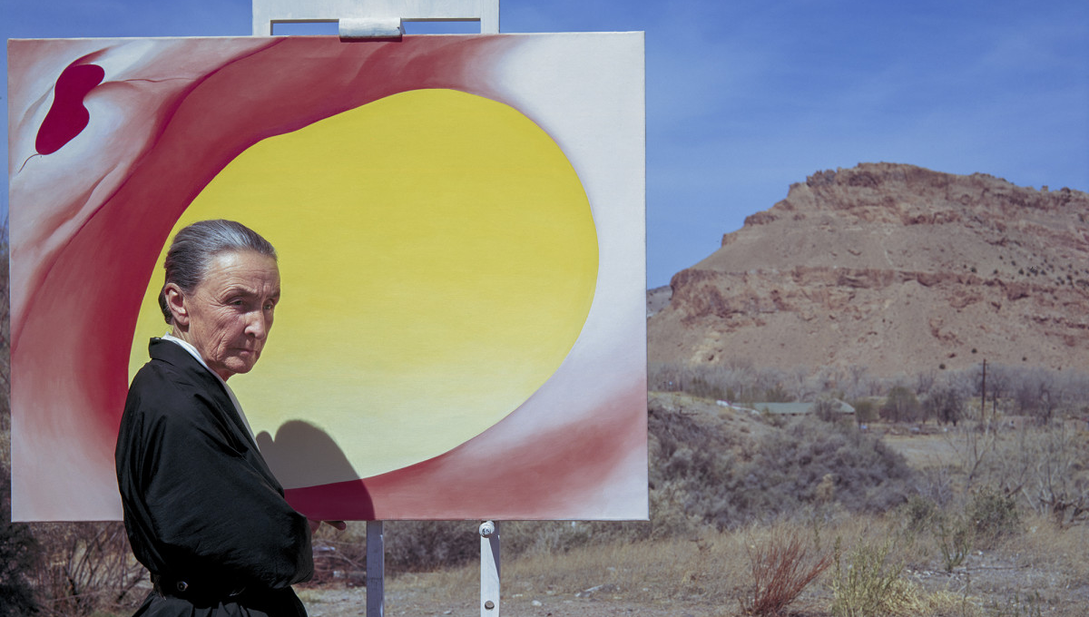
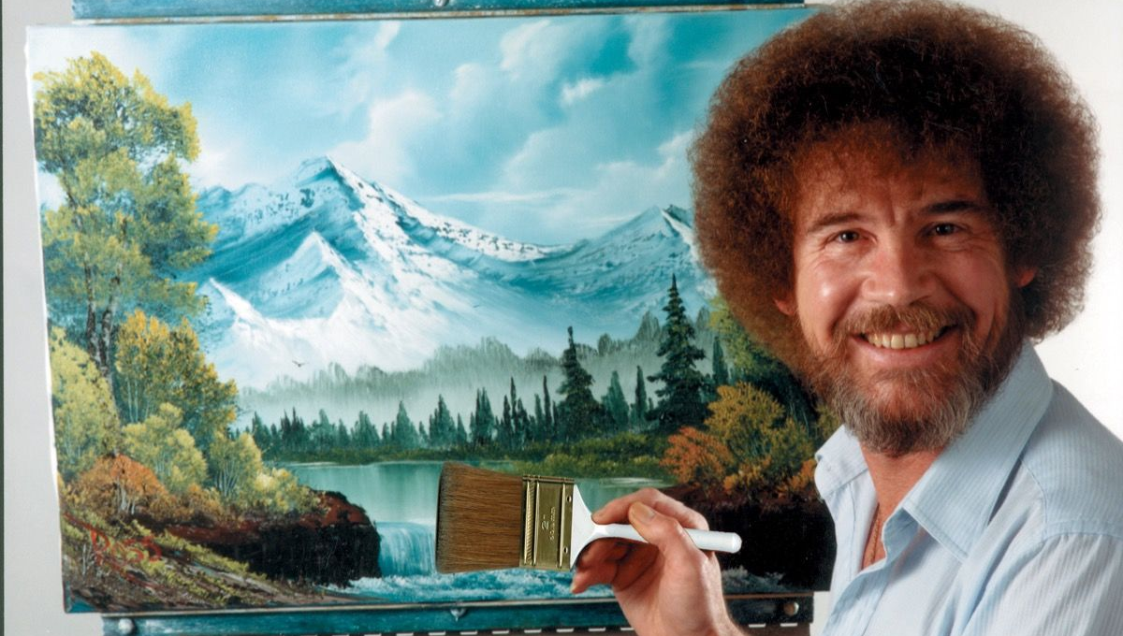
Lots of possible Artists

Slide 12
All from the same blueprint

Slide 13
Inheritance

Slide 14
Motivation
Dog

Slide 15
10 minute exercise: the Dog class
Write a class called Dog, with a constructor that takes in the following parameters:
name (the dog’s name)
age (the dog’s age in years)

Slide 16
Motivation
Dog
is also a
kind of
is a kind of
Dachshund
GreatDane

Slide 17
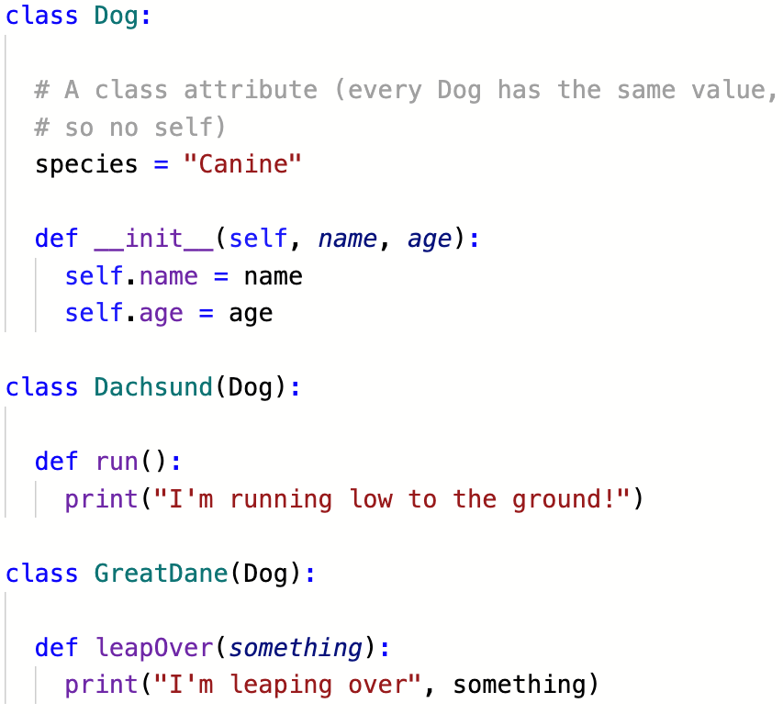
As (sub)classes

Slide 18
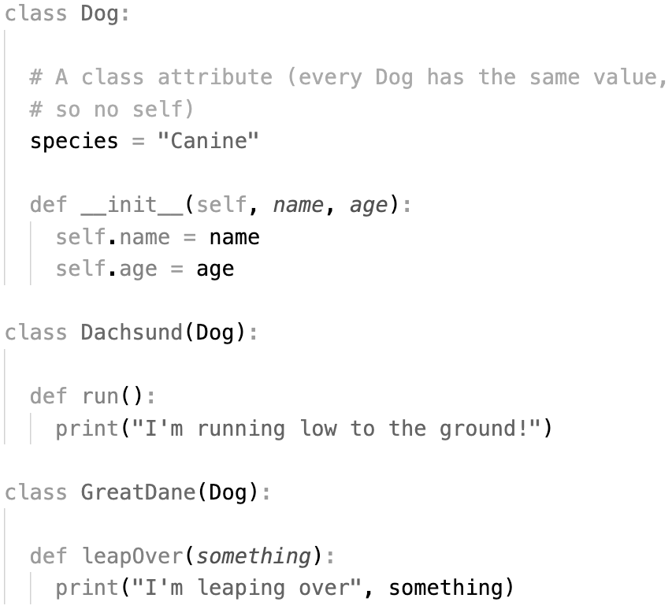
As (sub)classes
subclasses
“inherit”
all the
attributes
and methods
from their
parent class

Slide 19
As (sub)classes
they can also have
their own
attributes
and methods
separate from
their parent

Slide 20
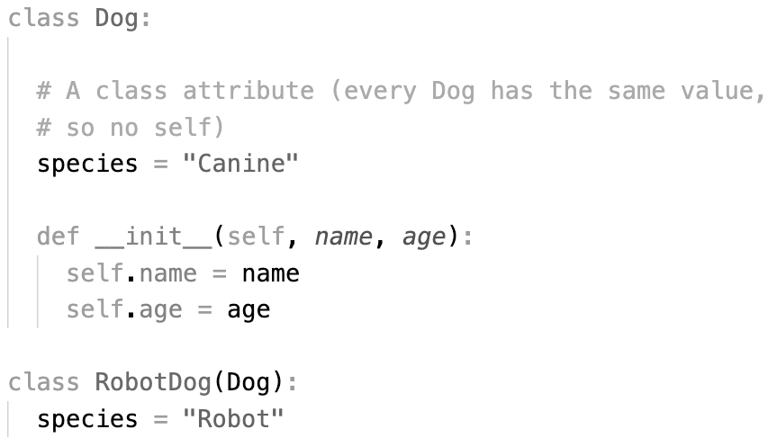
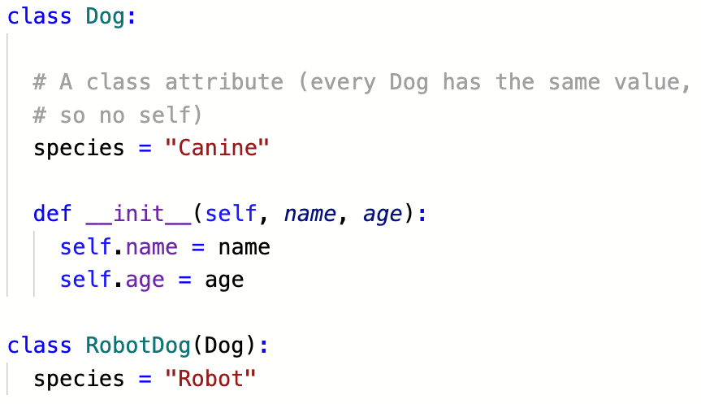
As (sub)classes
if necessary, they can override
attributes and methods
from their parent

Slide 21
Discussion
Why is this “inheritance” idea useful?

Slide 22
15 Minute Activity
Return to the Playlist class you wrote for your music library earlier.
Create a subclass, called Radio that fills a new Playlist with 10 random songs.
Create another subclass, called ShuffleList that has an additional method for randomly shuffling a Playlist.

